Slide 1
Machine Learning
Overview
Ch 2.2
Supervised vs. Unsupervised Learning

Slide 2
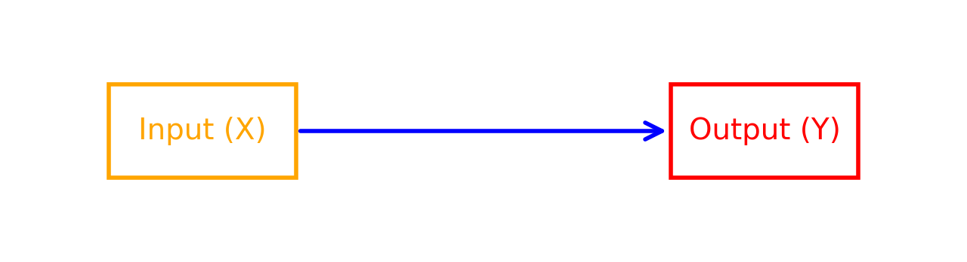
Supervised learning
Learns from being given “right answers”
Supervised learning uses examples with known answers.
Each example pairs input X with output Y.
The model learns the relationship between them.
This lets it predict Y for a new X, as shown in the graph.

Slide 3
Input (X)
Output (Y)
Application
email
spam? (0/1)
spam filtering
audio
text transcripts
speech recognition
English
Spanish
machine translation
ad, user info
click? (0/1)
online advertising
image, radar info
position of other cars
self-driving car
image of phone
defect? (0/1)
visual inspection
Notes:
Examples in Real Life
Suppose the input X is an email, and the output Y corresponds to classifying the email as "spam" or "not spam." This scenario represents the development of a spam filter.
Alternatively, if the input is an audio clip and the algorithm's task is to produce the text transcript, this application is known as speech recognition.
Machine translation is another example where input in one language results in output in another language, such as translating English to Spanish, Arabic, Hindi, Chinese, or Japanese.
In the realm of online advertising, supervised learning plays a crucial role. Large online ad platforms employ learning algorithms to predict whether a user will click on a particular ad, significantly impacting revenue.
The application of supervised learning extends to self-driving cars, manufacturing quality control, and more. In self-driving cars, the learning algorithm takes sensory input, such as images and radar data, to determine the position of nearby vehicles for safe navigation. Manufacturing uses visual inspection algorithms to identify defects in products, enhancing product quality.

Slide 4
Two groups of supervised learning algoriths
1- Regression:
Objective: Predicts a continuous quantity or value.
Example: Predicting house prices, stock prices, temperature forecasting.
2- Classification:
Objective: Predicts the category or class that an input belongs to.
Example: Email spam detection, image recognition (identifying objects in images), sentiment analysis.

Slide 5
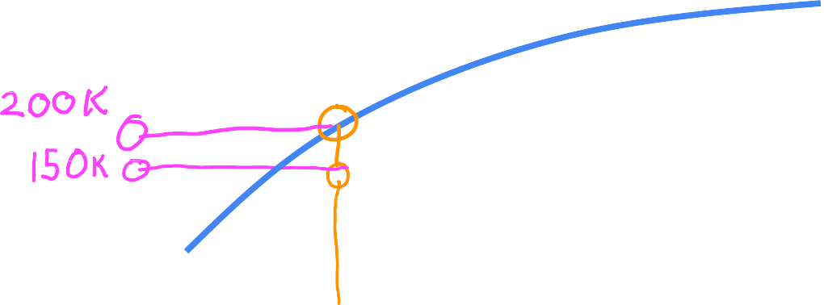











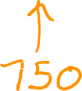
Regression: Housing price prediction
400
300
Price in
$1000's
200
Y = mX + B
100
0
0
500
2000
2500
Regression
Predict a number with
infinitely many possible outputs
1000 1500
House size in feet²
Notes:
A Specific Example: Predicting Housing Prices
Consider the task of predicting housing prices based on the house's size. By collecting data and plotting it, you can visualize the relationship between the size of a house and its price. The learning algorithm can be employed to fit a model to this data, which could be a straight line, a curve, or a more complex function.
By fitting a model, the algorithm can estimate the price of a house, like your friend's 750-square-foot house, based on the size. This example of housing price prediction falls under a category of supervised learning known as regression.

Slide 6




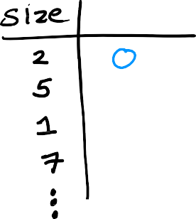






Classification: Breast cancer detection
1
0
tumor size 𝑥
(diameter in cm)
benign malignant
Notes:
Subtitle: Solving Real-World Problems
Imagine a scenario involving breast cancer detection. Your goal is to develop a machine learning system to aid doctors in diagnosing breast cancer, potentially saving lives through early detection. Using a patient's medical records, the system's task is to determine whether a tumor, represented as a lump, is malignant (cancerous) or benign (non-cancerous). Let's delve deeper into this problem.
Suppose your dataset contains tumors of various sizes, each labeled as either benign (denoted as 0) or malignant (denoted as 1). You can plot this data, where the horizontal axis represents tumor size, and the vertical axis indicates benign (0) or malignant (1).

Slide 7












Classification: Breast cancer detection
benign
malignant
malignant type 2
0cm
diameter(cm)
10cm
Classification predict categories
small number of possible outputs

Slide 8











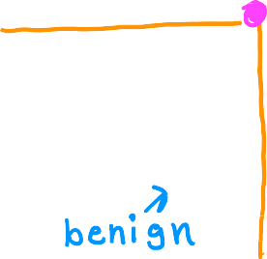




Two or more inputs
For example, your learning algorithm might predict multiple types of cancer diagnoses if the tumour is malignant
Age
Tumor size
Notes:
Multiple Inputs
Subtitle: Expanding Input Variables
In the examples discussed so far, we've used only one input value, such as tumor size. However, machine learning problems can involve multiple input variables. For instance, if you have information about both the patient's age and tumor size, your dataset will include two inputs: age and tumor size. In such cases, the learning algorithm will aim to find a boundary that separates malignant from benign tumors, incorporating both inputs.

Slide 9
Regression vs. Classification
Learns from being given “right answers”
Regression
Predict a number infinitely many possible outputs
Classification predict categories
small number of possible outputs
400
300
200
Age
100
0
0
500
2000
Tumor size

Slide 10
Machine Learning Overview
Unsupervised Learning Part 1

Slide 11
Previous: Supervised learning
Now: UnSupervised learning
In supervised learning, we focus on input-output mappings, where each example is associated with a specific output label (Y). For example, classifying tumors as benign or malignant
In contrast, unsupervised learning deals with data that lacks any output labels (Y). Consider a dataset with information on patients, tumor size, and age, but no information about tumor malignancy

Slide 12


Supervised learning Learn from data labeled with the “right answers”
Unsupervised learning Find something interesting in unlabeled data.
age
age
tumor size
tumor size
Notes:
In unsupervised learning, the objective is not to classify or diagnose tumors but to uncover inherent patterns, structures, or interesting features within the data.
Unsupervised learning includes a type of algorithm called clustering. Clustering algorithms group unlabeled data into clusters based on patterns they discover. Imagine you have a dataset with patient data but no tumor labels. An unsupervised clustering algorithm might discern two distinct groups or clusters in the data. It's like letting the algorithm find its way without predefined answers.

Slide 13
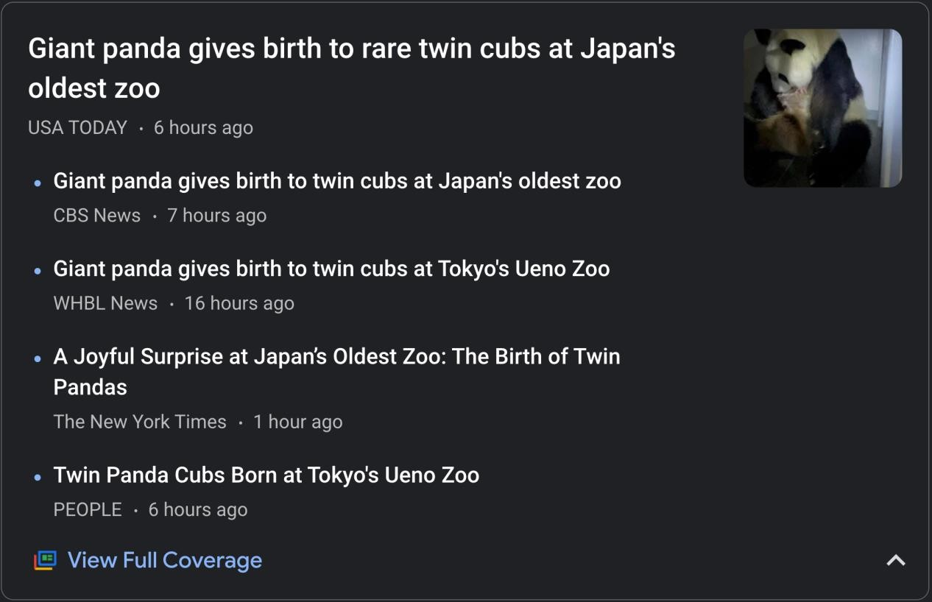










Clustering: Google news
Notes:
Google News employs clustering to group related news articles. Using algorithms, it scans hundreds of thousands of articles daily and groups stories with similar topics together. It identifies common words in headlines to cluster articles efficiently.

Slide 14



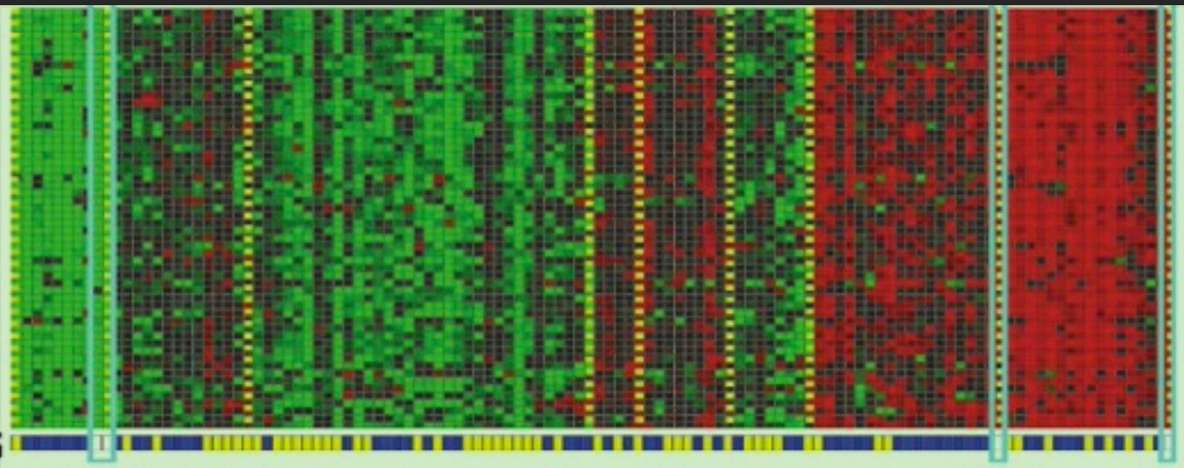







Clustering: DNA microarray
genes
(each row)
individuals
(each column)
Notes:
Clustering: DNA Microarray Data
Unsupervised learning also has applications in genetic data analysis, such as DNA microarrays. These grids represent genetic activity for different individuals. Clustering algorithms can group individuals into categories based on their genetic profiles, identifying types of people or patterns without predefined labels.

Slide 15
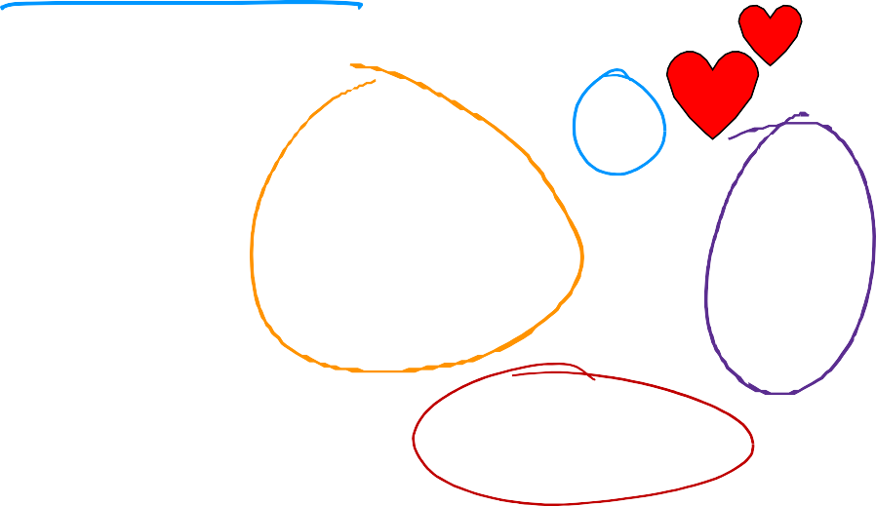

Clustering: Grouping customers
Businesses can group customers into segments
growing skills
and knowledge
develop
career
Clustering can be used to group community
inot clusters, as shown in the plot
stay updated
with AI
Notes:
Market Segmentation - Unsupervised Learning for Businesses
Businesses use unsupervised learning for market segmentation. By analyzing customer data, companies can automatically group customers into segments. For instance, identifying different customer motivations or behaviors within a community without prior labels.
Applying Unsupervised Learning to Community Insights
In a research project, the Deep Learning AI team applied unsupervised learning to understand their community better. They found distinct groups with unique motivations: knowledge seekers, career developers, and AI enthusiasts. This helped them tailor their services to better serve their community.

Slide 16
Machine Learning Overview
Unsupervised Learning Part 2

Slide 17
Unsupervised learning
Data only comes with inputs x, but not output labels y.
Algorithm has to find structure in the data.
Clustering
Group similar data
points together.
Dimensionality reduction Compress data using fewer numbers.
Anomaly detection
Find unusual data points.
Notes:
In unsupervised learning, the data is provided with inputs (X) but lacks output labels (Y). The primary objective in unsupervised learning is to discover underlying patterns, structures, or interesting information within the data. You already explored one type of unsupervised learning, clustering, in which similar data points are grouped together.
In this specialization, you will delve into unsupervised learning further, focusing on three key types:
• Clustering: The clustering algorithm groups similar data points together.
• Anomaly Detection: Used to identify unusual events, this is crucial in applications like fraud detection in financial systems.
• Dimensionality Reduction: This technique enables the transformation of a large dataset into a much smaller one, preserving the essential information.
The concepts of anomaly detection and dimensionality reduction will become clearer as you progress through the specialization.

Slide 18

Question
Of the following examples, which would you address using
an unsupervised learning algorithm?
Given email labeled as spam/not spam, learn a spam filter.
Given a set of news articles found on the web, group them into sets
of articles about the same story.
Given a database of customer data, automatically discover market segments and group customers into different market segments.
Given a dataset of patients diagnosed as either having diabetes or not, learn to classify new patients as having diabetes or not
Notes:
Evaluating Understanding with an Example
Now, let's test your understanding. Please select which of the following examples are instances of unsupervised learning:
Spam filtering based on labeled data.
Grouping news articles using a clustering algorithm.
Market segmentation based on customer data.
Diagnosing diabetes with labeled data.
You should recognize that spam filtering and diagnosing diabetes with labeled data are supervised learning tasks since they have predefined labels (Y). In contrast, grouping news articles and market segmentation are unsupervised learning tasks since they involve uncovering patterns or structures in the data without predefined output labels.
In the upcoming sections, we'll dive deeper into anomaly detection and dimensionality reduction, expanding your understanding of unsupervised learning.

Slide 19
Machine Learning Overview
Jupyter Notebooks

Slide 20
Jupyter Notebook - Your Interactive Learning Environment
Jupyter Notebook is an essential tool for interactive learning in machine learning and data science.
What is Jupyter Notebook?
Jupyter Notebook is an open-source web application that allows you to create and share documents that contain live code, equations, visualizations, and narrative text.

Slide 21
Why Use Jupyter Notebook?
Interactive Learning: Jupyter Notebook allows you to experiment with code, explore data, and visualize results interactively.
Ideal for Experiments: You can run code one line at a time, making it perfect for trying out different machine learning algorithms and concepts.
Document Your Work: Combine code, text, and visualizations in a single document, making it easy to share and understand your work.

